Slide 1
CEQA Case Law
CEQA AND HISTORIC PRESERVATION
March 19, 2014: 11:00 am to 11:45 am
California Preservation Foundation
University of Southern California
Deborah M. Rosenthal, AICP, Esq.
Sheppard Mullin Richter & Hampton, LLP
#418641500

Slide 2
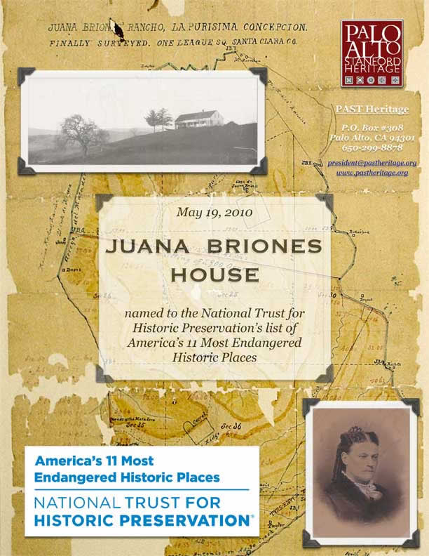
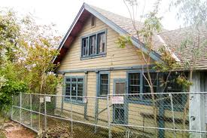
What is a Project?
Ministerial Demolition / Building Permits
  Prentiss v. City of South Pasadena (1993) 15 Cal.App.4th 85
  Friends of Juana Briones House v. City of Palo Alto (2010) 190 Cal.App.4th 286

Slide 3
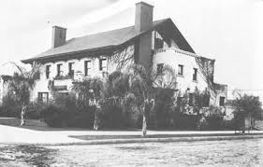
What is a Project? (cont.)
Discretionary Demolition/Building Permits
  San Diego Trust & Savings Bank v. Friends of Gill (1981) 121 Cal.App.3d 203

Slide 4
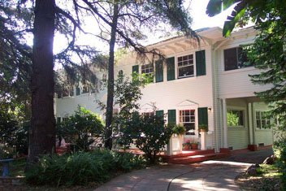
What is a Project? (cont.)
Pre-commitment to Project
  Save Tara v. City of West Hollywood (2008)
  45 Cal.4th 116
  Cedar Fair, LP v. City of Santa Clara (2011)
  194 Cal.App.4th 1150
Save Tara
  City of Irvine v. City of Orange (2013)
  221 Cal.App.4th 846

Slide 5
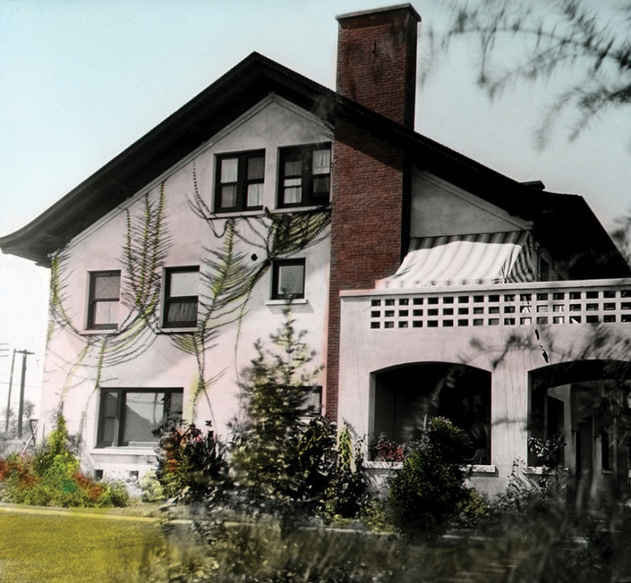
What is a Project? (cont.)
Project “As A Whole” Must Be Considered
  San Diego Trust & Savings Bank v. Friends of Gill (1981) 121 Cal.App.3d 203
  Friends of Juana Briones House v. City of Palo Alto (2010) 190 Cal.App.4th 286
Melville Klauber House

Slide 6

Is the Project Exempt?
Consistent with Specific Plan
  Concerned Dublin Citizens v. City of Dublin (2013) 214 Cal.App.4th 1301
Infill/Single Family
  Valley Advocates v. City of Fresno (2008) 160 Cal.App.4th 1039

Slide 7
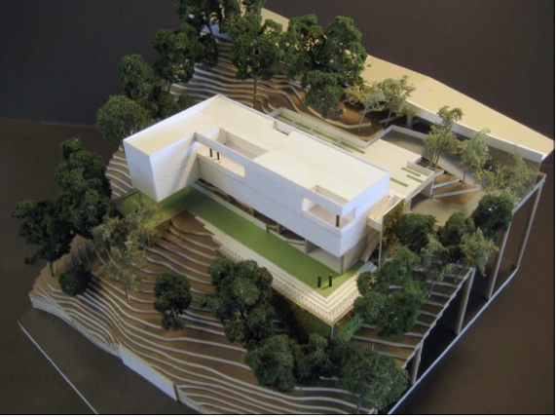
Is the Project Exempt? (cont.)
“Unusual circumstances”
  Berkeley Hillside Preservation v. City of Berkeley (2012) 203 Cal.App. 4th 656 (review granted)

Slide 8
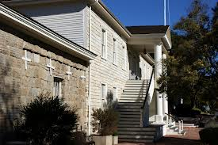
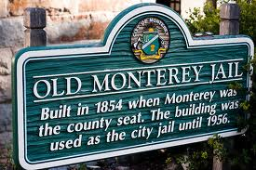
Significant Adverse Impacts
Fair argument – Negative Declaration
  Architectural Heritage Association v. City of Monterey (2004) 122 Cal.App. 1095

Slide 9
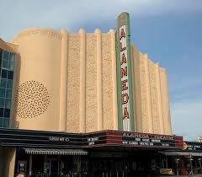
Significant Adverse Impacts (cont.)
Substantial evidence – EIR
Substantial evidence – Subsequent documentation
  Citizens for a Megaplex-Free
  Alameda v. City of Alameda
  (2007) 149 Cal.App.4th 91

Slide 10
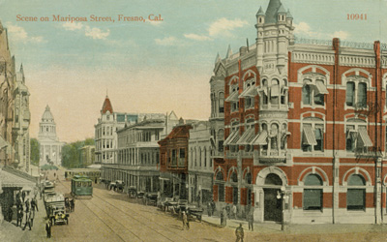
What is an Historic Resource?
Cultural, architectural or historic
  Architectural Heritage Association v. City of Monterey (2004) 122 Cal.App. 1095
Obligation to investigate
  Valley Advocates v. City
  of Fresno (2008)
  160 Cal.App.4th 1039
Mariposa Street, Fresno

Slide 11
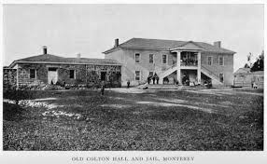
Are Impacts Clearly Mitigated?
Architectural Heritage Association v. City of Monterey (2004) 122 Cal.App. 1095
Old Monterey Jail

Slide 12
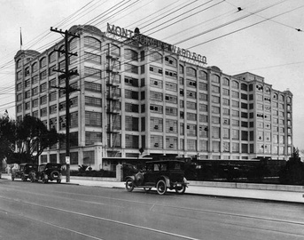
Feasible Mitigation Measures
League for Protection of Oakland’s Architectural and Historic Resources v.
City of Oakland (1997)
52 Cal.App.4th 896
Montgomery Ward

Slide 13
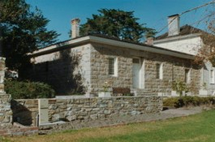
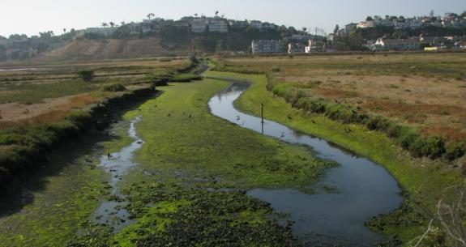
Adequate and Preferred Mitigation Measures?
Architectural Heritage Association v. City of Monterey (2004) 122 Cal.App. 1095
Ballona Wetlands Land Trust v. City of Los Angeles (2011) 201 Cal.App.4th 455
Madera Oversight Coalition, Inc. v. County of Madera (2011) 199 Cal.App.4th 48
Old Monterey Jail
Ballona Wetlands

Slide 14
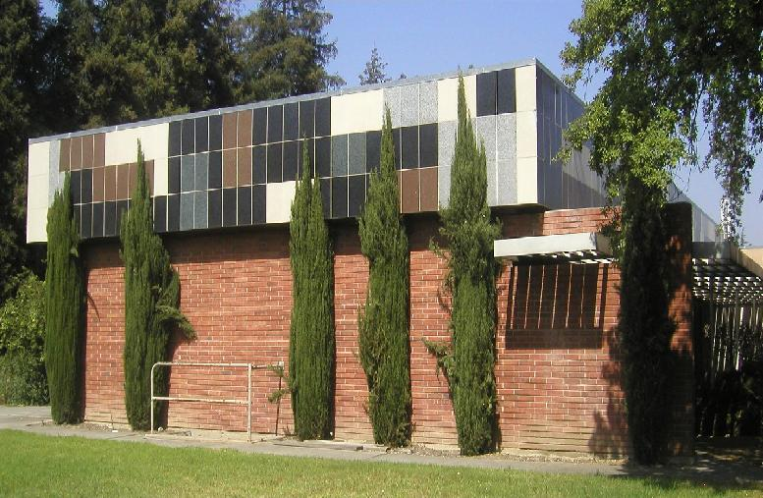
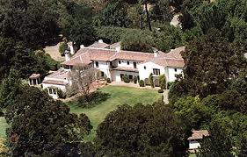
Feasible Alternatives to Avoid or Reduce Impacts
Factual, financial and legal alternatives
  Preservation Action Council v. City of San Jose (2006) 141 Cal.App.4th 1336
  Uphold Our Heritage v. City of Woodside (2007) 147 Cal.App.4th 587
Jackling House
IBM Building 25

Slide 15
Substantial Evidence
Facts and expert opinion
  Architectural Heritage Association v. City of Monterey (2004) 122 Cal.App. 1095

Slide 16
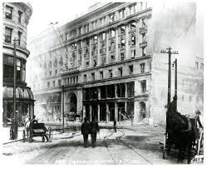
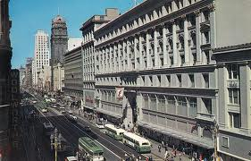
Findings
Economic Feasibility
  San Franciscans Upholding the Downtown Plan v. City and County of San Francisco (2002) 102 Cal.App.4th 656
Alternatives
  South County Citizens for Smart Growth v. County of Nevada (2013) 221 Cal.App.4th 316

Slide 17
Standing and
Administrative Exhaustion
administrative hearings
in court

Slide 18
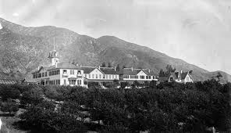
Avoid CEQA Review
City initiative
  Friends of Sierra Madre
  v. City of Sierra
  Madre (2001)
  25 Cal.4th 165
Public initiative
  Tuolumne Jobs & Small Business Alliance v.
  Superior Court (2013) 210 Cal.App.4th 1006
  (review granted)

Slide 19
QUESTIONS?
Deborah M. Rosenthal, AICP, Esq.
Sheppard Mullin Richter & Hampton, LLP
650 Town Center Drive, 4th Floor
Costa Mesa, CA 92626
(714) 424-2821
drosenthal@sheppardmullin.com

